Slide 1


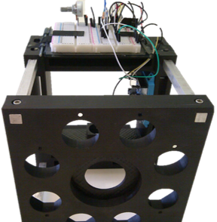
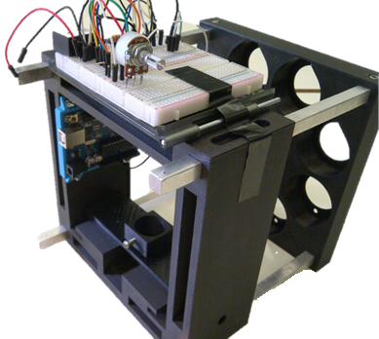
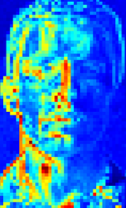
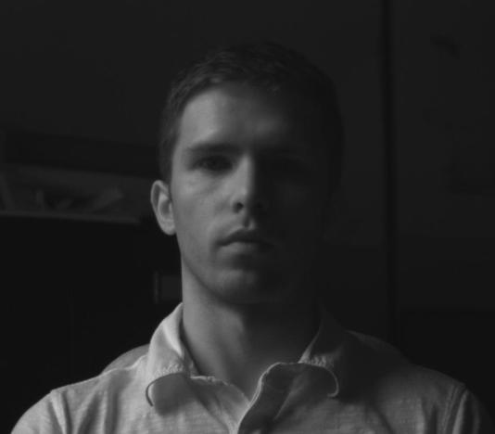
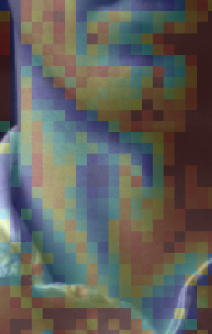
Title Title Title Title Title Title Title Title Title
First Authorª (email@uwaterloo.ca), Second Author^{b}, Third Author^{a,b}
ªVision and Image Processing Group, Department of Systems Design Engineering, University of Waterloo, Canada ^{b}Affiliation2
Introduction
Methods/Design (depending on what makes most sense for you)
Introduction
Background
Summarize main findings here. Bold key words as part of findings in this column. Limit to key take-aways. Aim to use short sentences. Aim to use plain language. A good rule of thumb: use terminology such that, regardless of field, anyone can understand 80% of what you’re saying.
Background with bolded key points to guide reader. Include references like this [1]. Use at least 24 point fonts (28 point recommended) for legibility. Aim to not include too much information. Consider this info talking points you can expand on with your verbal discussion. Include just enough info to make sense as a stand-alone. Readers don’t need to understand all the nitty gritty details, focus on the very most important points and aim for 3-5 while addressing:
What’s the problem? Use a very short paragraph to describe.
What’s been done? Use a very short paragraph to describe.
What are the gaps? Use a very short paragraph to describe.
Figure 1. Figure caption text here….
Figure 2. Figure caption text here….
.
Results
Use diagrams wherever possible
Don’t cram results.
Use point form if needed.
Include short descriptions to walk reader through your poster.
Goal
The goal(s) of this study were to:
Use numbers to break up goals into primary and secondary etc. outcomes. This is very effective at helping the reader pick up the main points quickly
Use bulleted lists to emphasize the “so what” Of each goal
Bold key words to emphasize aspects of the goal.
Include 3-5 SHORT bullet points to
include next steps
This works well
For
talking points
Future Directions
Figure 3. Figure caption text here….
.
[1] Feel free to use a very condensed citation here with just enough info to find the source with as little space as possible
[2] Poh. M.-Z., McDuff, D. J., Picard, R. W. Non-contact automated cardiac pulse measurements using video imaging and blind source separation. Optics Express (2010).
[3] Sun, Y., Hu, S., Azorin-Peris, V., Azorin-Peris, V., Greenwald, S., Chambers, J., Zhu, Y. Motion-compensated noncontact imaging photoplethysmography to monitor cardiorespiratory status during exercise. Journal of Biomedical Optics (2011).
[4] Gray, H. Anatomy of the Human Body. Philadelphia: Lea & Febiger, 1918; Bartleby.com, 2000. www.bartleby.com/107/.
This work was supported by … The authors thank … (Acknowledgements).

